Slide 1
The Data Warehouse
Lecturer: Ngo Huy Bien
Software Engineering Department
Faculty of Information Technology
VNUHCM - University of Science
Ho Chi Minh City, Vietnam
nhbien@fit.hcmus.edu.vn

Slide 2

Objectives

Slide 3

Contents

Slide 4

References
W.H. Inmon (2003). Building The Data Warehouse. Wiley.
Ralph Kimball and Margy Ross (2002). The Data Warehouse Toolkit - The Complete Guide to Dimensional Modeling. Wiley.

Slide 5
Database Systems Goals [1]
The primary focus of the early database systems was operational—usually transactional—processing.
A more sophisticated notion of the database has emerged—one that serves operational needs and another that serves informational or analytical needs.

Slide 6
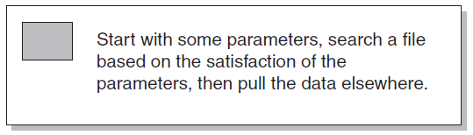
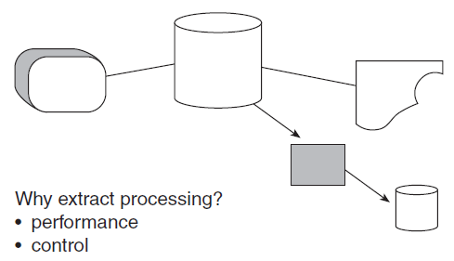
Extract Program/Processing

Slide 7
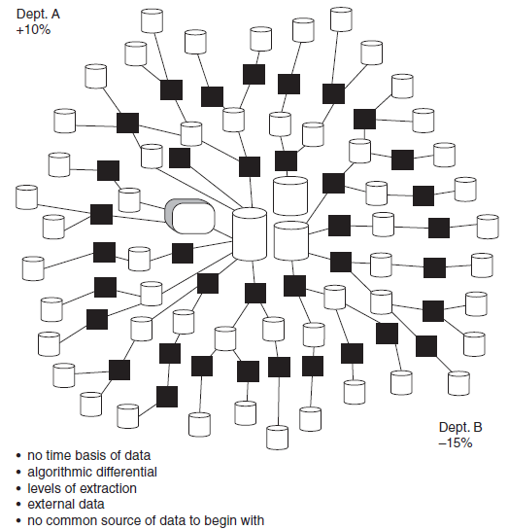
Naturally Evolving Architecture

Slide 8
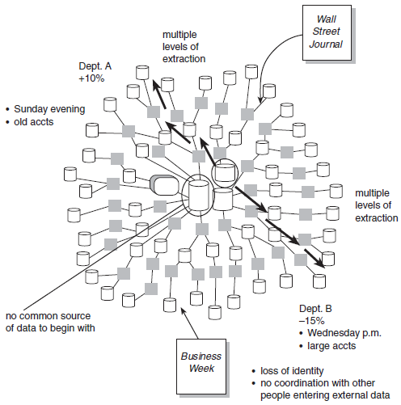
Lack of Data Credibility

Slide 9
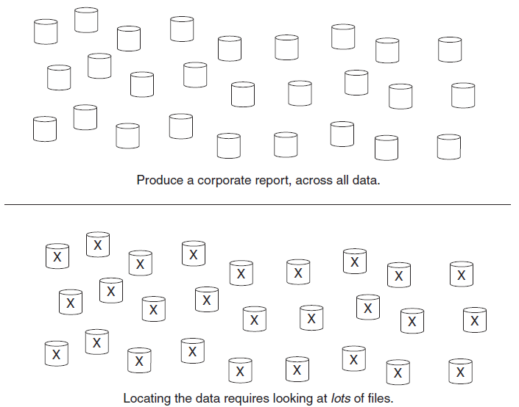
Problems with Productivity I

Slide 10
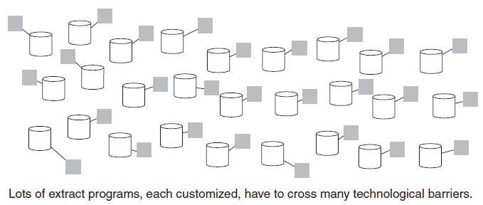
Problems with Productivity II

Slide 11
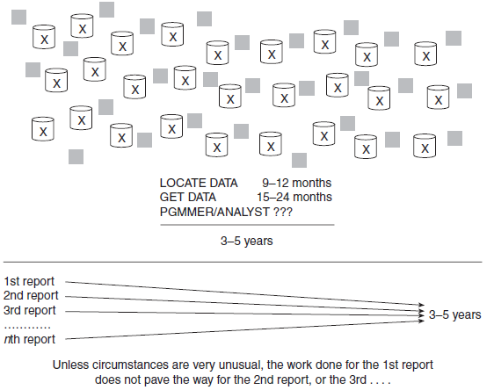
Problems with Productivity III

Slide 12
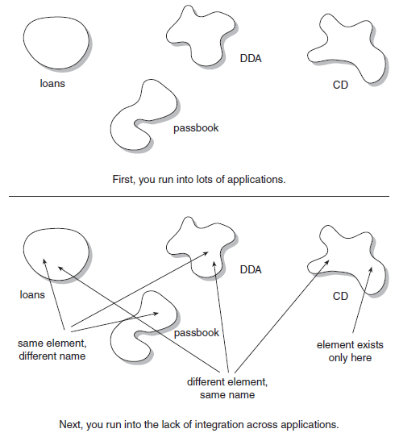
From Data to Information
How has account activity been different this year from each of the past five years for the financial institution?

Slide 13
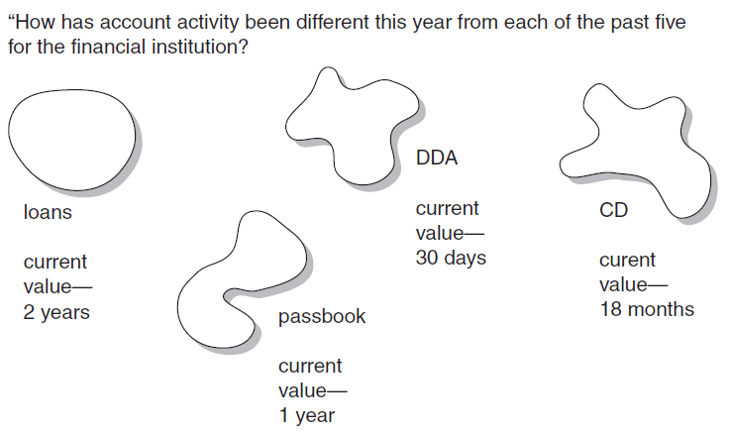
Historical Data Problem

Slide 14


Slide 15
Primitive Data vs. Derived Data I
There are fundamentally two kinds of data at the heart of an “architected” environment — primitive data and derived data.
Primitive data is detailed data used to run the day-to-day operations of the company. Derived data has been summarized or otherwise calculated to meet the needs of the management of the company.
Primitive data can be updated. Derived data can be recalculated but cannot be directly updated.
Primitive data is primarily current-value data. Derived data is often historical data.

Slide 16
Primitive Data vs. Derived Data II
Primitive data is operated on by repetitive procedures. Derived data is operated on by heuristic, non-repetitive programs and procedures.
Operational data is primitive; decision support system (DSS) data is derived.
Primitive data supports the clerical function. Derived data supports the managerial function.
Primitive data and derived data are so different that they do not reside in the same database or even the same environment.

Slide 17
Levels of Data I
The operational level of data holds application-oriented primitive data only and primarily serves the high-performance transaction-processing community.
The data-warehouse level of data holds integrated, historical primitive data that cannot be updated.
The departmental environment—sometimes called the data mart level, the OLAP level, or the multidimensional DBMS level—contains information useful to the different parochial departments of a company.
Individual data is usually temporary and small. Much heuristic analysis is done at the individual level.

Slide 18
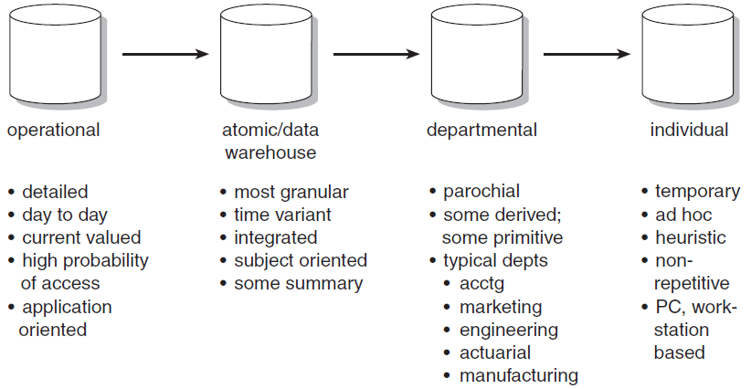
Levels of Data II

Slide 19
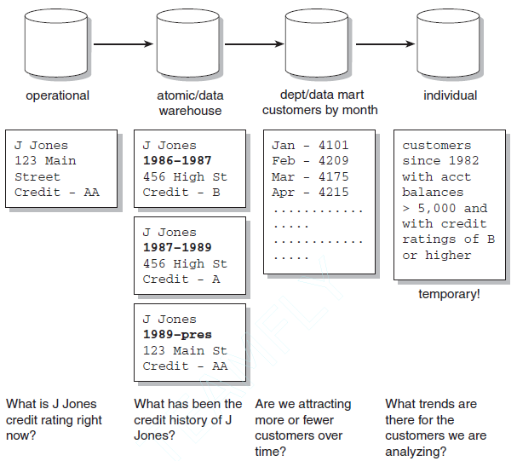
Kinds of Queries

Slide 20
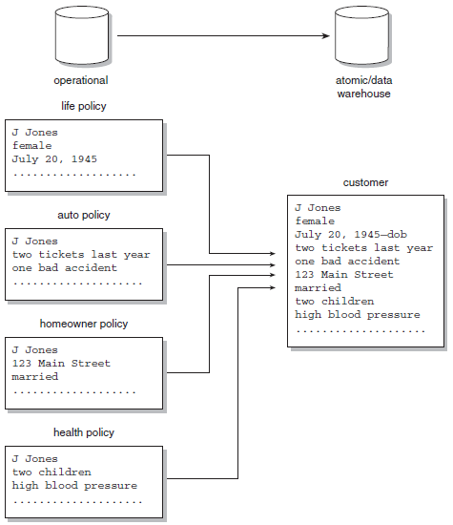
Data Integration

Slide 22
What is a Data Warehouse
A data warehouse is a subject-oriented, integrated, nonvolatile, and time-variant collection of data in support of management’s decisions.
The data warehouse contains granular corporate data.

Slide 23
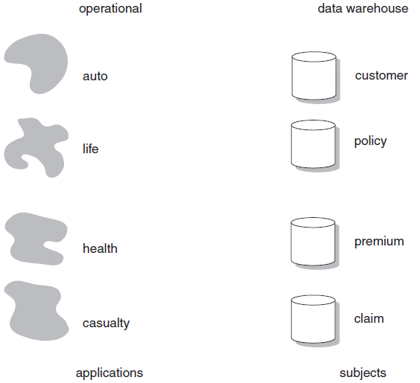
Subject Orientation of Insurance Company Data

Slide 24
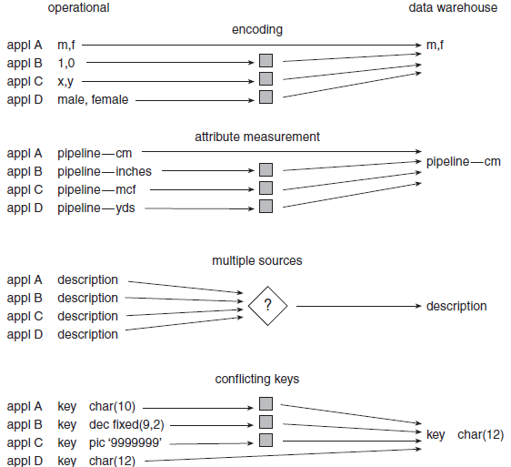
Integration Issue

Slide 25
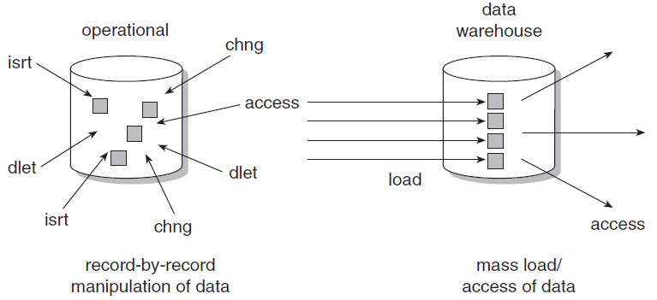
Non-volatility of Data

Slide 26
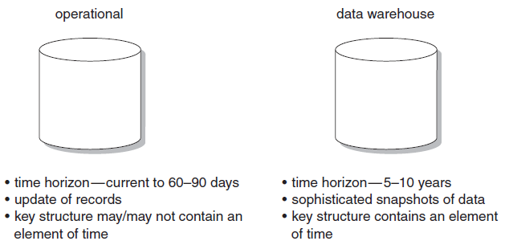
Time Variancy
Time variancy implies that every unit of data in the data warehouse is accurate as of some one moment in time.
Different environments have different time horizons.
A time horizon is the parameters of time represented in an environment.

Slide 27
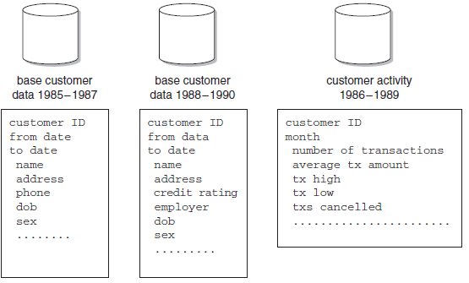
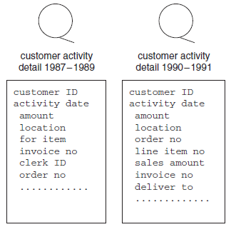
Major Subject Area
The data warehouse is oriented to the major subject areas of the corporation that have been defined in the high-level corporate data model.
Data warehouse data is organized by major subject area—in this case, by customer.

Slide 28
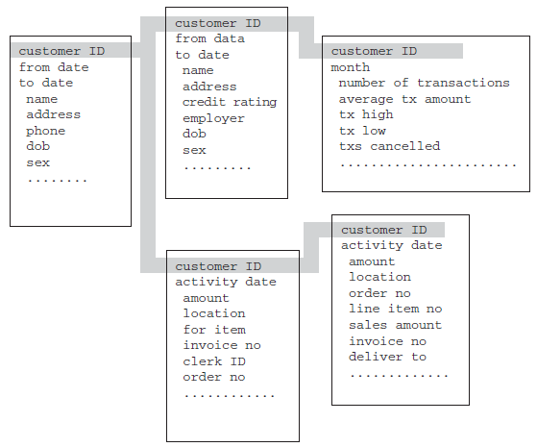
Physical Implementation
Each major subject area is physically implemented as a series of related tables in the data warehouse.
A subject area may consist of 10, 100, or even more physical tables that are all related.
All of the physical tables for the customer subject area are related by a common key.

Slide 29
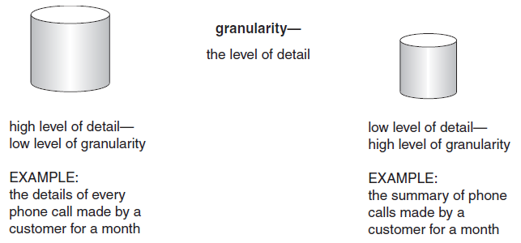
Granularity
Granularity refers to the level of detail or summarization of the units of data in the data warehouse.
The more detail there is, the lower the level of granularity.
The less detail there is, the higher the level of granularity.

Slide 30
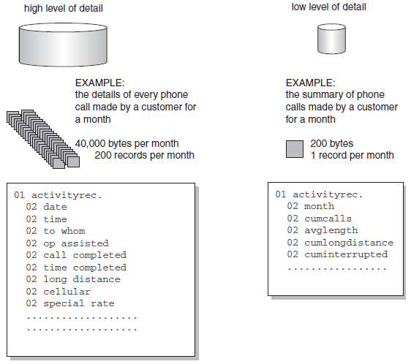
Granularity Example

Slide 31
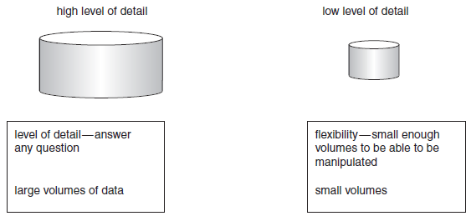
Determining the Level of Granularity
When data is compacted, significant savings can be realized in the amount of direct access storage device (DASD) used, the number of index entries required, and the processor resources required to manipulate data.
As the level of granularity of data rises, there is a corresponding loss in the ability to answer queries using the data.

Slide 32
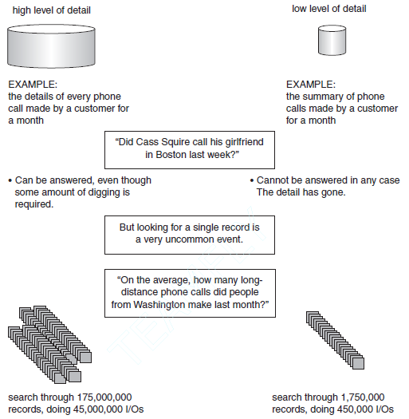
Effect of Granularity Example

Slide 33
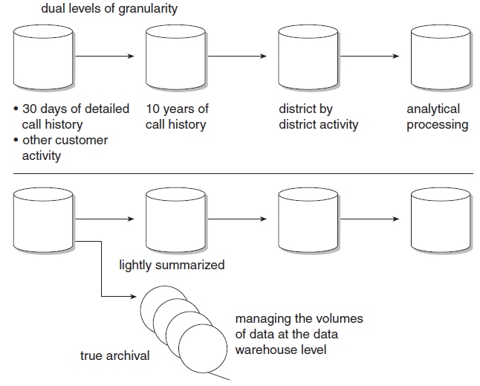
Dual Levels of Granularity

Slide 34
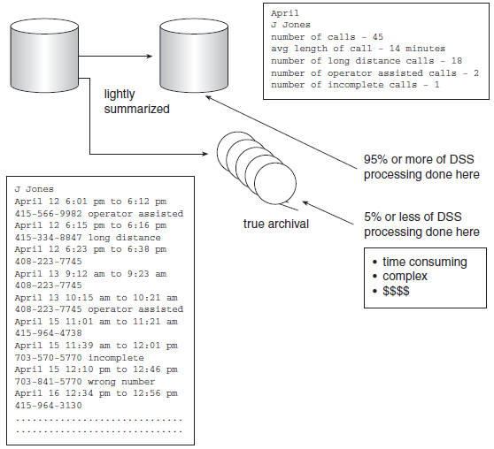
Dual Levels of Granularity Example

Slide 35
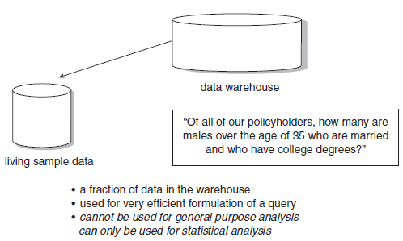
Living Sample Database
The living sample database refers to a subset of either true archival data or lightly summarized data taken from a data warehouse.
The term “living” stems from the fact that it is a subset—a sample—of a larger database, and the term “sample” stems from the fact that periodically the database needs to be refreshed.

Slide 36
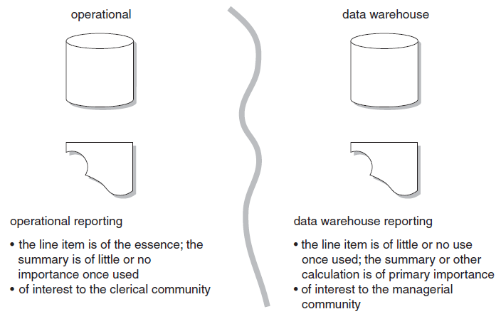
Reporting

Slide 37
Incorrect Data
Suppose that on July 1 an entry for $5,000 is made into an operational system for account ABC.
On July 2 a snapshot for $5,000 is created in the data warehouse for account ABC.
Then on August 15 an error is discovered. Instead of an entry for $5,000, the entry should have been for $750.
How can the data in the data warehouse be corrected?
Using update capabilities, replace the value $5,000 with the value $750.
Enter offsetting entries. Two entries are made on August 16, one for $5,000 and another for $750.
Reset the account to the proper value on August 16. An entry on August 16 reflects the balance of the account at that moment regardless of any past activity.

Slide 39
Data Models
The corporate data model focuses on and represents only primitive data.
Performance factors are added into the corporate data model as the model is transported to the existing systems environment.
A fair number of changes are made to the corporate data model as it is applied to the data warehouse.

Slide 40
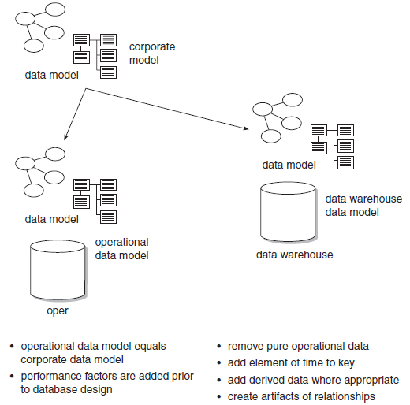
Different Levels of Modeling

Slide 41
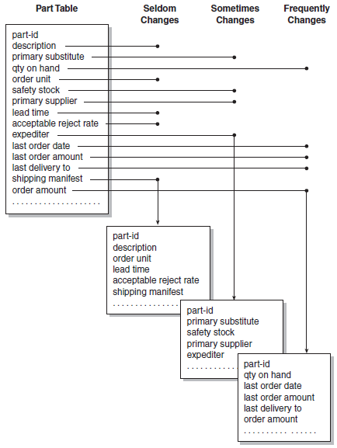
Stability Analysis
Data that seldom changes is grouped.
Data that sometimes changes is grouped.
Data that frequently changes is grouped.

Slide 42
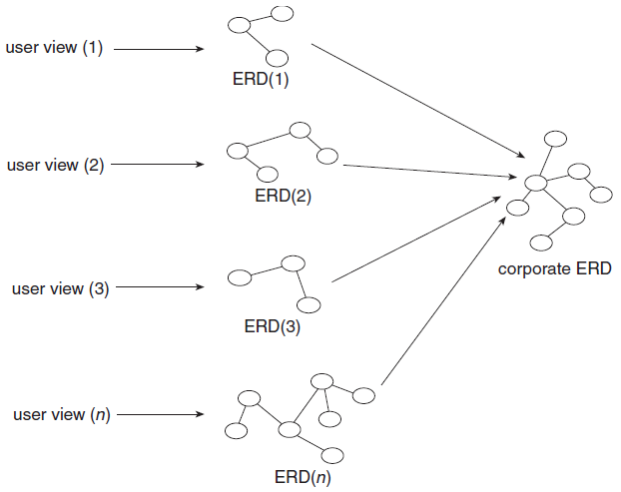
Corporate ERD

Slide 43
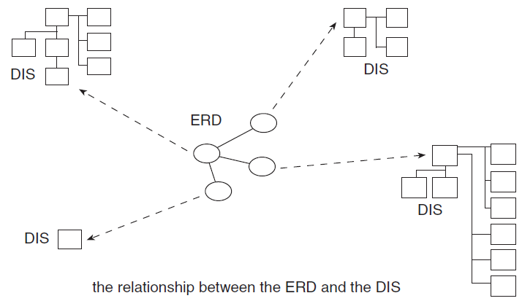
Data Item Set
Each entity in the ERD is further defined by its own DIS.

Slide 44
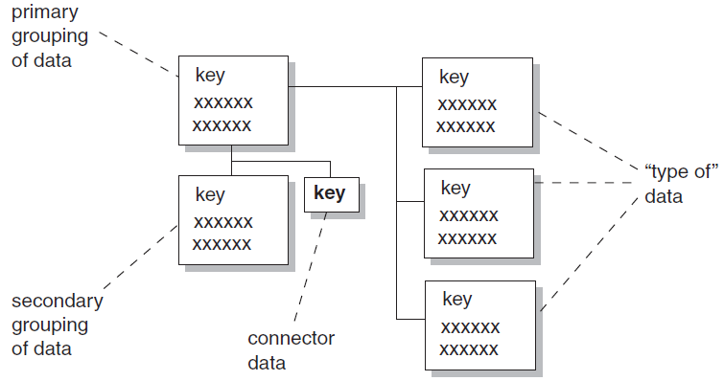
Four Constructs Making Up Midlevel Data Model

Slide 45
Four Constructs
The primary grouping exists once, and only once, for each major subject area. It holds attributes that exist only once for each major subject area.
The secondary grouping holds data attributes that can exist multiple times for each major subject area.
The connector relates data from one grouping to another.
“Type of” data is indicated by a line leading to the right of a grouping of data. The grouping of data to the left is the super-type. The grouping of data to the right is the subtype of data.

Slide 46
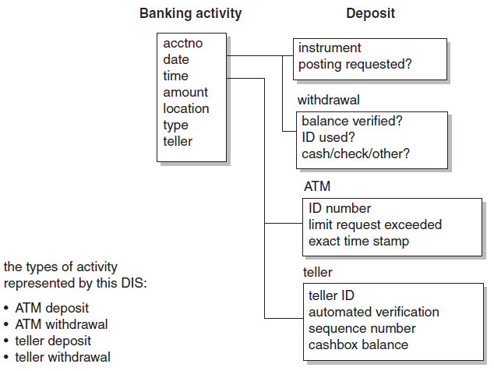
“Type of” Data Example
One type of criteria is by activity type—either a deposit or a withdrawal.
The other line indicates another—either an ATM activity or a teller activity.
Collectively, the two types of activity encompass the following transactions:
ATM deposit
ATM withdrawal
Teller deposit
Teller withdrawal

Slide 47
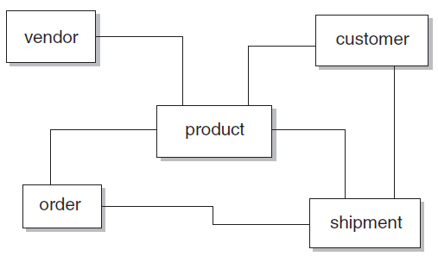
Two-Dimensional Data Model
A simple two-dimensional data model gives the impression that all entities are equal.
Approaching database design for the data warehouse solely from the perspective of the data model produces a “flat” effect.

Slide 48
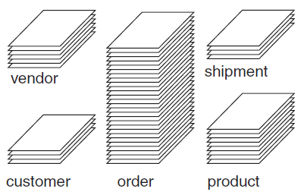
Three-Dimensional Data Model
A three-dimensional perspective of the entities shows that the entities are anything but equals.
Some contain far more occurrences of the data than others.

Slide 49
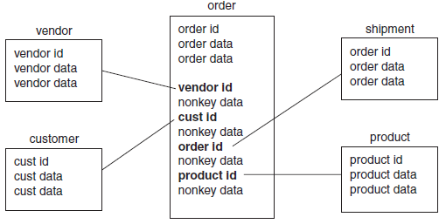
Star Join
The design structure that is required to manage large amounts of data residing in an entity in a data mart is called a “star join.”
The center of the star join-ORDER-is called the “fact table.”
The surrounding entities—PART, DATE, SUPPLIER, and SHIPMENT—are called “dimension tables."

Slide 50
Star Join and Data Mart
The star join applies as a design foundation to the very large entities that will exist in the data mart.
The data mart structures are typically known as multidimensional structures and are served by OLAP technology.
Because the data mart is a load-and-access environment, because the data mart contains historical data, and because massive amounts of data need to be managed, the star join data structure is ideal for the processing that occurs inside the star join.

Slide 51
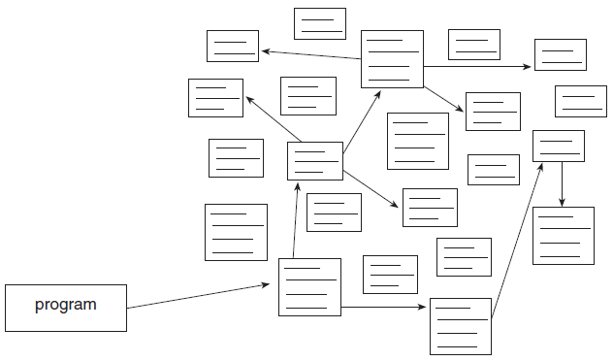
Normalization Drawbacks
When there are many tables, much I/O is required for dynamic interconnect-ability.

Slide 52
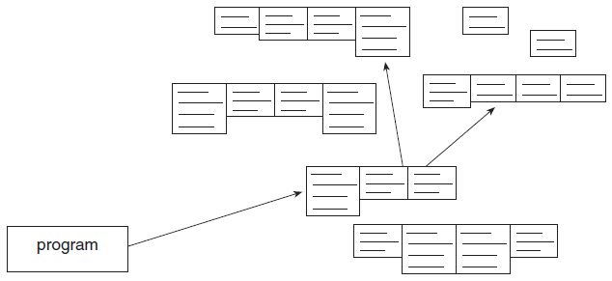
Denormalization: Merging Tables
When tables are physically merged, much less I/O is required.

Slide 53
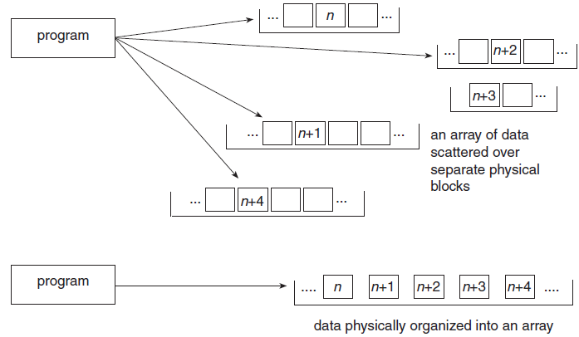
Denormalization: Creating Arrays of Data
Under the right circumstances, creating arrays of data can save considerable resources.

Slide 54
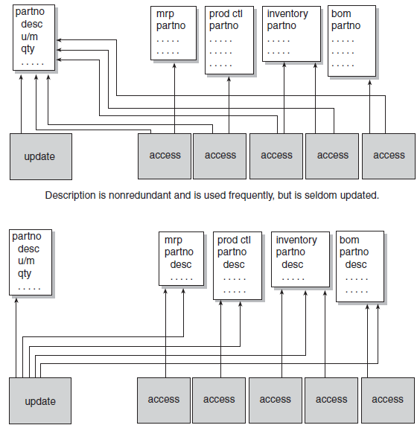
Denormalization: Redundant Data

Slide 55
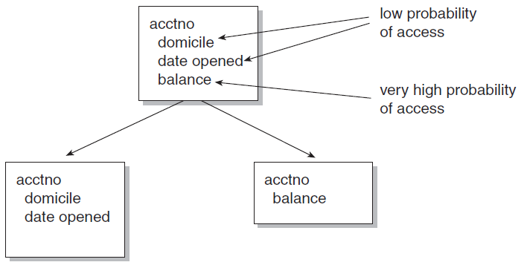
Denormalization: Further Separation of Data
Further separation of data based on a wide disparity in the probability of access.

Slide 56
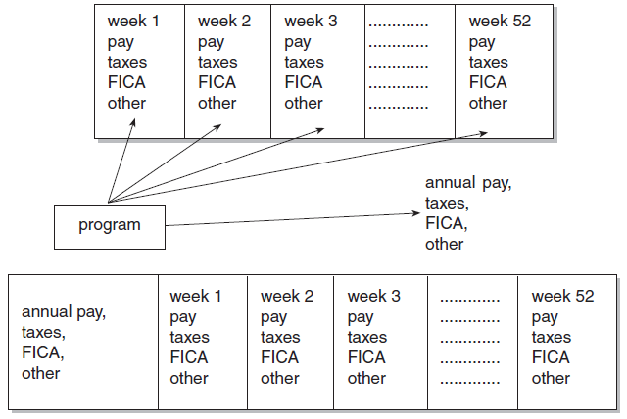
Denormalization: Derived Data
Derived data, calculated once, then forever available.

Slide 57
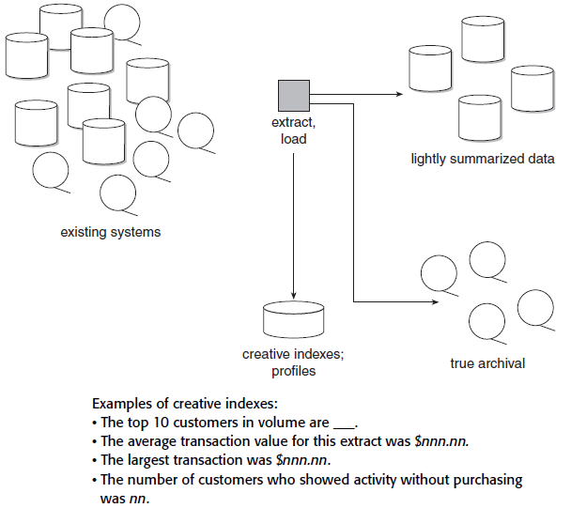
Denormalization: Creative Indexes/Profiles

Slide 58
Referential Integrity
In the operational environment, referential integrity appears as a dynamic link among tables of data.
But because of the volume of data in a data warehouse, because the data warehouse is not updated, and because the warehouse represents data over time and relationships do not remain static, relationships of data are represented by an artifact in the data warehouse environment.
Therefore, some data will be duplicated, and some data will be deleted when other data is still in the warehouse.
In any case, trying to replicate referential integrity in the data warehouse environment is a patently incorrect approach.

Slide 60
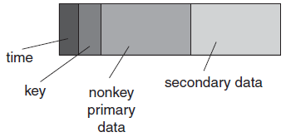
Snapshots in the Data Warehouse
Each of the data warehouses centers around a structure of data called a “snapshot.”
The snapshot triggered by an event has four basic components:
A key
A unit of time
Primary data that relates only to the key
Secondary data captured as part of the snapshot process that has no direct relationship to the primary data or key
A data warehouse record of data is a snapshot taken at one moment in time and includes a variety of types of data.

Slide 61
Meta Data
Meta data then acts like an index to the contents of the data warehouse.
It sits above the warehouse and keeps track of what is where in the warehouse.
Typically, items the meta data store tracks are as follows:
Structure of data as known to the programmer
Structure of data as known to the DSS analyst
Source data feeding the data warehouse
Transformation of data as it passes into the data warehouse
Data model
Relationship between the data model and the data warehouse
History of extracts

Slide 62
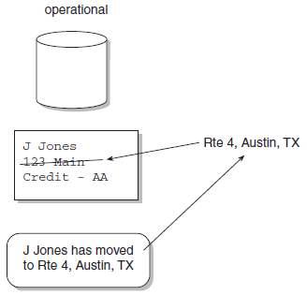
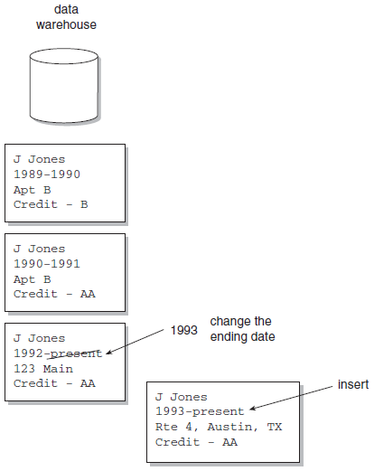
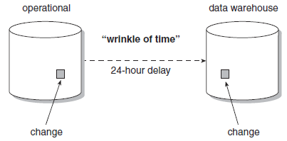
Cyclicity of Data

Slide 63
Complexity of Transformation and Integration
Data relationships that have been built into old legacy program logic must be understood and unraveled before those files can be used as input.
Multiple input sources of data exist and must be merged as they pass into the data warehouse.
When there are multiple input files, key resolution must be done before the files can be merged.
Multiple outputs may result. Data may be produced at different levels of summarization by the same data warehouse creation program.
Massive volumes of input must be accounted for.

Slide 64
Extract/Transform/Load (ETL)
ETL software automates the process of converting, reformatting, and integrating data from multiple legacy operational sources.
Only under very unusual circumstances does attempting to build and maintain the operational/data warehouse interface manually make sense.

Slide 65
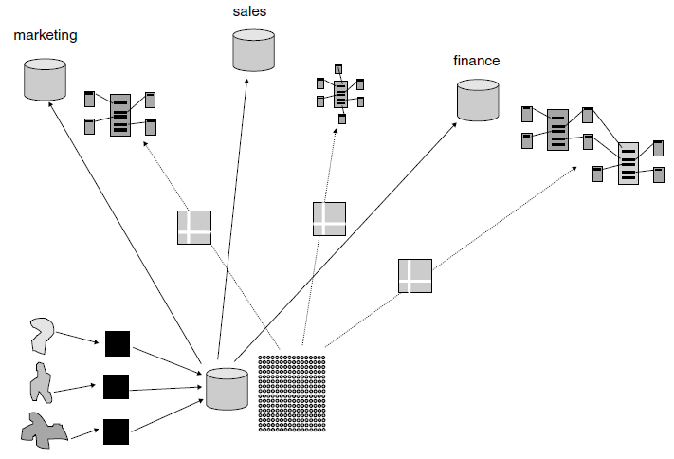
Data Warehouse and Data Mart

Slide 67
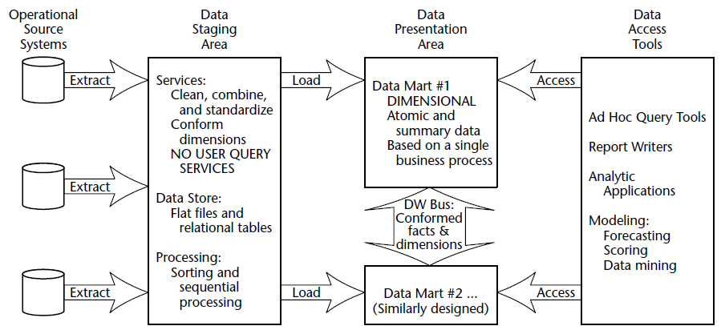
Data Warehouse Components [2]

Slide 68
Data Staging Area
The data staging area of the data warehouse is both a storage area and a set of processes commonly referred to as extract-transformation-load (ETL).
The key architectural requirement for the data staging area is that it is off-limits to business users and does not provide query and presentation services.

Slide 69
Data Presentation
The data presentation area is where data is organized, stored, and made available for direct querying by users, report writers, and other analytical applications.
The data be presented, stored, and accessed in dimensional schemas.

Slide 70
Dimensional Modeling
Dimensional modeling is a new name for an old technique for making databases simple and understandable.
“We sell products in various markets and measure our performance over time.”
As dimensional designers, we listen carefully to the CEO’s emphasis on product, market, and time.
Most people find it intuitive to think of this business as a cube of data, with the edges labeled product, market, and time.
Points inside the cube are where the measurements for that combination of product, market, and time are stored.

Slide 71
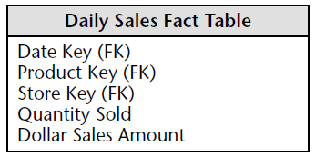
Fact Table
A fact table is the primary table in a dimensional model where the numerical performance measurements of the business are stored.
We use the term fact to represent a business measure.
A measurement is taken at the intersection of all the dimensions (day, product, and store).

Slide 72

Dimension Tables
Dimension tables are integral companions to a fact table.
The dimension tables contain the textual descriptors of the business.

Slide 73

Dimensional Model
The fact table consisting of numeric measurements is joined to a set of dimension tables filled with descriptive attributes.
This characteristic star-like structure is often called a star join schema.

Slide 74

Reporting Dimensional Attributes and Facts

Slide 75
Dimensional vs. 3NF Modeling
Dimensional modeling is quite different from third-normal-form (3NF) modeling.
3NF modeling is a design technique that seeks to remove data redundancies.
Normalized modeling is immensely helpful to operational processing performance because an update or insert transaction only needs to touch the database in one place.
Normalized models, however, are too complicated for data warehouse queries.

Slide 76
Converting 3NF Model to Dimensional Model
If you already have an existing normalized ER diagram, the first step in converting it into a set of dimensional models is to separate the ER diagram into its discrete business processes and then model each one separately.
The second step is to select those many-to-many relationships in the ER diagrams that contain numeric and additive non-key facts and designate them as fact tables.
The final step is to de-normalize all the remaining tables into flat tables with single-part keys that join directly to the fact tables.
These tables become the dimension tables.

Slide 77

Thank You & See You Again

